Slide 1
Finding your way with MapInfo RouteFinder
The Premier routing and driving region solution for MapInfo Pro

Slide 2
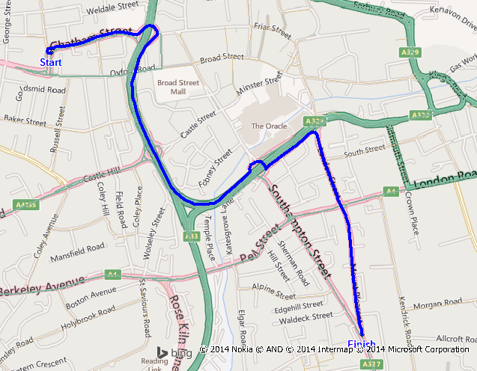
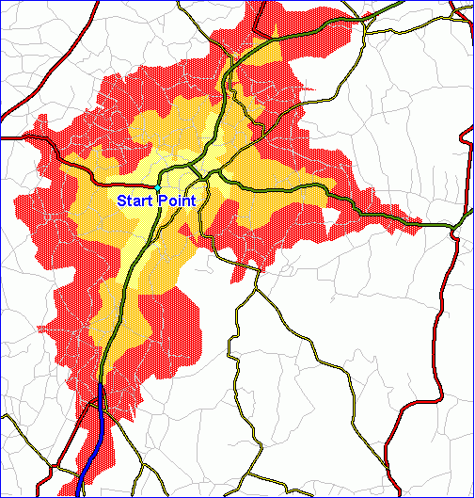
What is MapInfo RouteFinder?
An add-on to MapInfo Professional that
creates routes and driving regions
for the purposes of doing site and market analysis
and improving efficiencies.

Slide 3
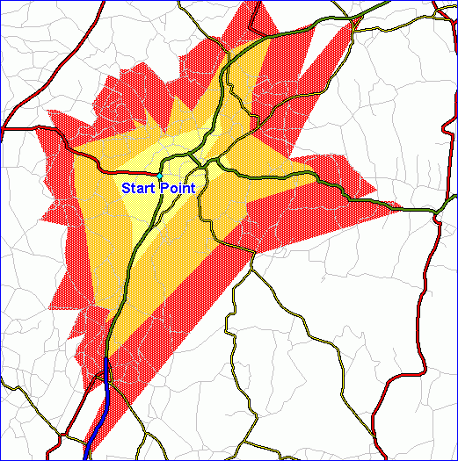
How is RouteFinder used?
  To help a retailer analyse and choose sites for new stores.
  To help a property developer determine the best sort of business to bring into a property.
  To help an organisation choose the optimal site for an office relocation.
  To provide information so that a call centre in an organisation can route callers to their nearest store or outlet.
  To help a government agency plan a network of offices for their services.
  To help optimise the route for a series of deliveries.
  To help an insurance company determine how far policy holders are from their work locations.

Slide 4
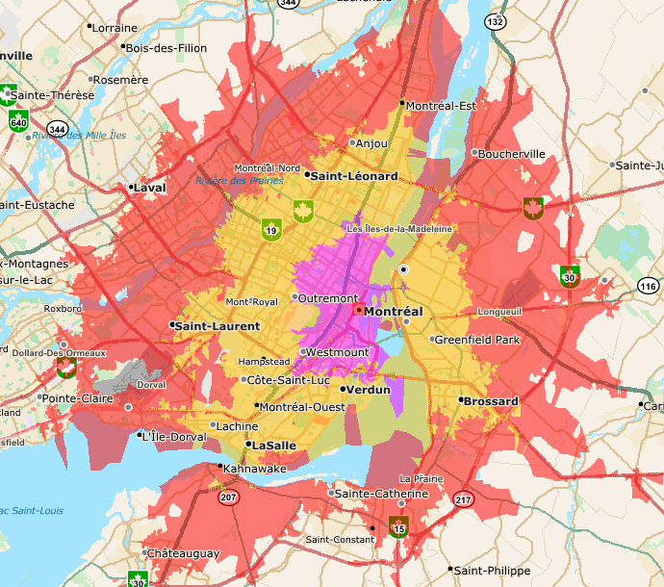
Perform site analysis
Creating driving regions (isochrones or isodistances)
A driving region represents the distance or time that can be reached in all directions from a given starting point.
Driving regions can be used to analyse customer counts, demographics or other data.
Useful in site analysis and selection.
Routing network and background map are StreetPro Canada. ©TomTom BV

Slide 5
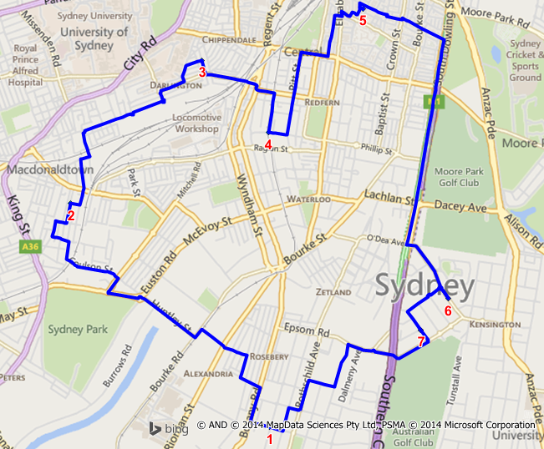
Schedule visits effectively (“Traveling Salesperson” calculations)
Traveling salesperson calculates the optimal route to a set of destination locations.
It can be used to help efficiently schedule a number of stops or visits.
The road network used in the example above is StreetPro Australia ©TomTom BV. The background map is Microsoft Bing Roads

Slide 6
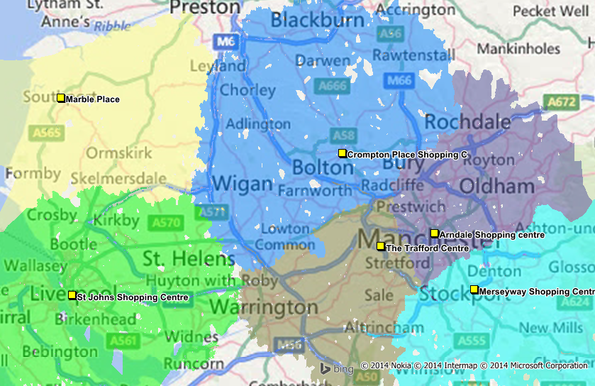
Create territories/boundaries (catchments)
The colored area around each store represents the closest store using the road network.
A maximum of 60 minutes was used in this calculation.
Areas not colored are more than 60 minutes from the stores.
The road network is StreetPro UK ©TomTom BV. The background mapping in the map above is the Microsoft Bing Roads map.

Slide 7
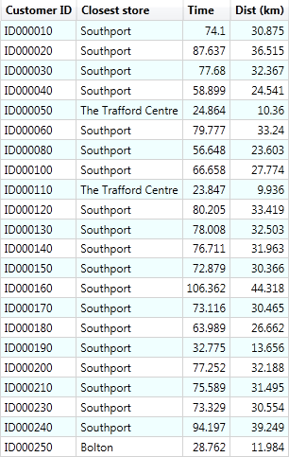
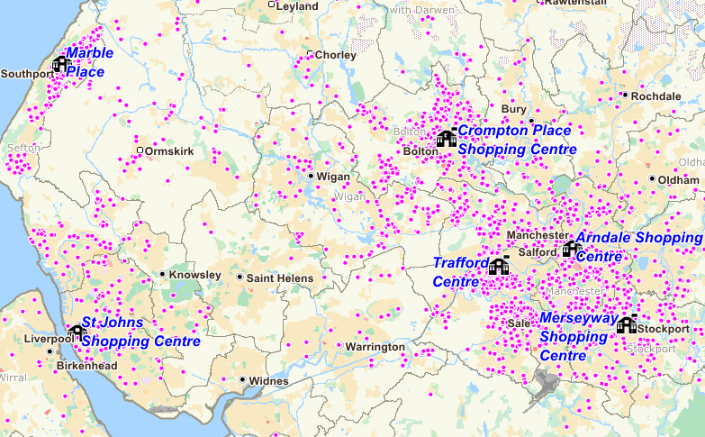
Determine the nearest store for a large number of customers
  Can calculate multiple destination locations for each customer.
Background map is StreetPro UK ©TomTom BV.

Slide 8

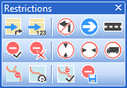
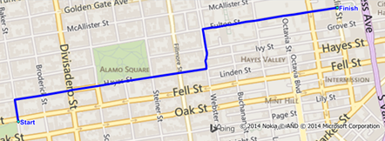
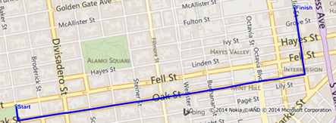
Powerful and flexible routing and driving region calculations
Perform batch or interactive operations.
Modify the road network to account for construction, driving restrictions or other changes.
Calculate routes and driving regions based on different transport modes such as walking and driving.
  Create your own custom modes.
Shortest route
Quickest route

Slide 9
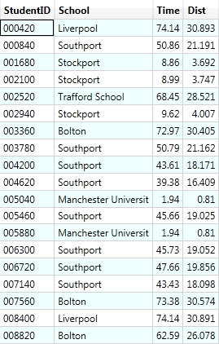
Calculate and analyse distances between origin and destination locations
Given pairs of origins and destinations, it is possible to calculate travel times and distances.
Other example uses:
Customers to stores
Patients to hospitals
Locations of stolen and recovered autos (determine possible route taken)
Employees distances between home and office locations

Slide 10
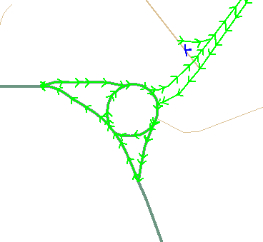
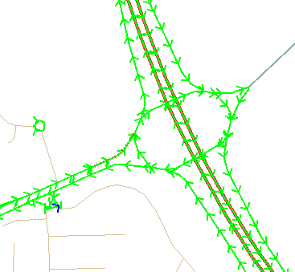
RouteFinder networks
Pitney Bowes offers basic and premium networks for many countries.
Premium networks include TomTom Speed Profiles data (observed speed data) for more accurate routes and driving regions.
  Morning peak
  Afternoon peak
  Weekly average
  Night average
  Interpeak (off
  peak average)

Slide 11
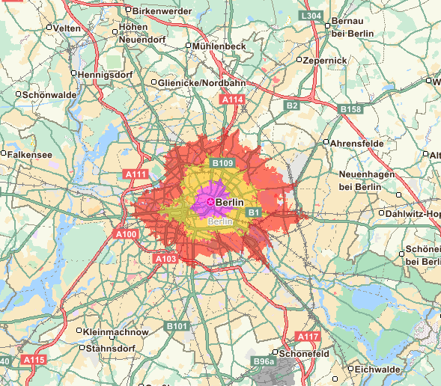
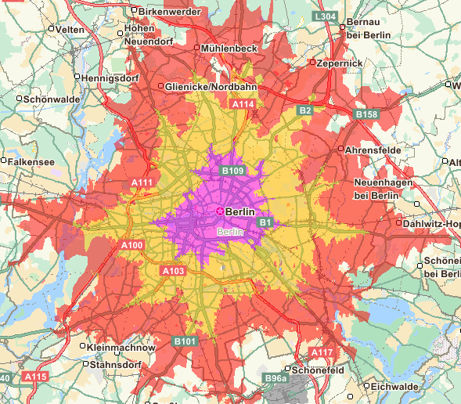
Comparison of modelled speeds with observed speeds
The StreetPro Premium network offers routing and driving region calculations based on observed driving speeds.
5, 10 and 15 minute driving regions in Berlin, Germany
AM Peak time traffic speeds (Premium network)
Standard modelled speeds (Standard network)

Slide 12
MapInfo RouteFinder Road Map

Slide 13
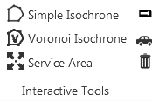



MapInfo RouteFinder v5.0 goes 64 bit
Development scheduled to be completed in March 2016.
General release in April
Theme | Improvement
Platform and user interface | Native 64 bit version New ribbon based user interface
Routing enhancements | More flexible route options More functions take advantage of dynamic segmentation (improvement in accessing/departing the route network) Improved support for different vehicle types
Performance | Significantly reduced time to complete many calculations
Network | Extended tab file support: Create and use larger networks.
Product road map is subject to change

Slide 14
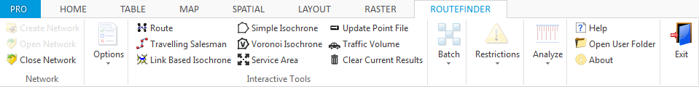
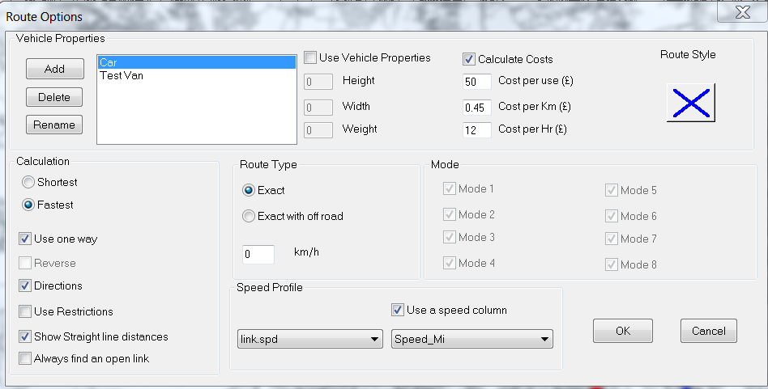
MapInfo RouteFinder v5.0
New ribbon based user interface
Expanded route options
And more!!

Slide 15
More info on MapInfo RouteFinder
Overview in “The MapInfo Pro” journal: Click here
Video tutorials: Click here
  Routing and proximity analysis with MapInfo RouteFinder
  Creating isochrones with MapInfo RouteFinder
Free trial available
Contact your MapInfo VAR or PB sales rep for a free trial.

Slide 16
Thank you!

